Slide 1
ISM 6136
Data Mining
Dr. Tim Smith

Slide 2
Agenda
More on Data Preparation
Example: Preparing data for Linear Regression
Introduction to Classification Modeling
Logistic Regression
Model Evaluation and the Confusion Matrix

Slide 3
Data Preparation

Slide 4
Drop unnecessary Features/Columns
Drop any variables that you wouldn’t know before knowing the target
For instance, if you’re creating a model to predict the sale price of a home, you wouldn’t know the tax paid until the house sells.
Drop any variables that would not have and predictive power:
Someone's phone number wouldn’t help determine their educational level.

Slide 5
Missing Values
If missing too many values in a column, drop the column
If missing too many values in an observation (row), drop the row
If missing a target value, drop the observation
For the remaining missing values, impute
For numeric values - replace with mean or median
For categorical/object values – replace with the value that has the highest frequency of occurance

Slide 6
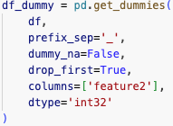
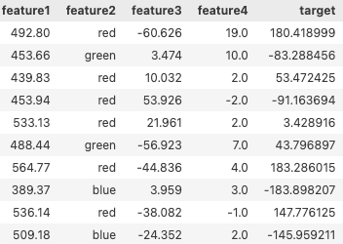
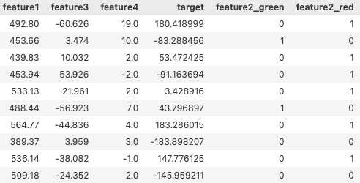

Dummy Encoding
2nd – Encode the Variable
1st – Determine/Check Classes of the Variable

Slide 7
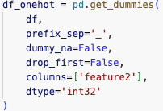

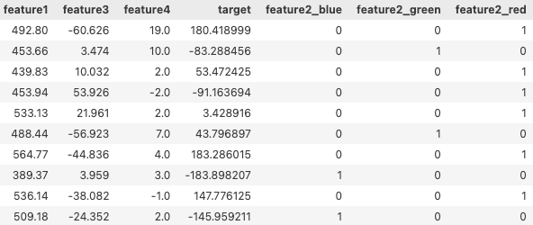
OneHot Encoding
2nd – Encode the Variable
1st – Determine/Check Classes of the Variable

Slide 8
Where can things go wrong?
Missing values
Three Options: Drop, Impute or leave as NaN
Typos
Check unique values
For instance, you could find [Red, red, blue, green].
Solution: Rename values Red to red

Slide 9
Classification Models (Classifiers)

Slide 10
Learning outcomes :
Understand the difference between a classification model and linear regression.
Understand the difference between binary classification modeling and multiclass classification modeling.
Know examples of both binary and multiclass classification modeling.

Slide 11
Classification Modeling
So far, we’ve used linear regression modeling to find patterns between continuous input variables and a continuous target variable.
…But, what about non-continuous targets?
When we attempt to predict a non-continuous target (aka category) we create a ‘classifier’ (also referred to as a classification model)

Slide 12
Classification
In many areas, decisions are made on a “yes” or “no” basis. This is called binary classification.
1. Credit score: give credit or not
2. Spam or not: corporate email
3. Fraudulent credit card transaction or not
4. Hospital - operate or wait (the triage problem) [MASH unit]
5. Invest or not: $1B fund
6. Travel or not: critical corporate personnel or senior government officials

Slide 13
Classification
When the decision involves more than two classes, then it is called multiclass classification.
1. Character Recognition: Digits 0 through 9
2. Medical Diagnostics: Retinal scans to detect Diabetic Retinopathy (mild, moderate, severe, or proliferative)
3. Product Classification: Input an image and a description, and identify if the product is under the electronics category, clothes, etc.

Slide 14
Logistic Regression

Slide 15
Regression vs Classification
Classification
Regression
Predicted Value
Actual Value
Target (y)
Predict Blue
Target (y)
Predict Green
Predictor (X1)
Predictor (X1)

Slide 16

Linear Regression
Regression
$\hat{y}$= b₀+ b₁x₁+ …
y = $\hat{y}$+ error
y = b₀ + b₁x₁ + error
Predicted Value
Actual Value
Target (y)
Note: For simplicity, I’m referring to the difference between the predicted a value and the observed as error. In statistics, this is often referred to as the residual and the term error is reserved to denote errors in measurement (irreducible error).
Predictor (x₁)

Slide 17
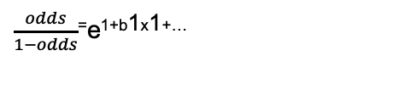

Logistic Regression
Classification
P (y=green | x1=?) = $\frac{1}{1−e−(B0+B1∗x1+..)}$
Let’s say, we’re looking for P(C=1)…
Target (y)
Predict Blue
Predict Green
$\frac{odds}{1−odds}$⁼e^{1+b1x1+…}
Predictor (X1)

Slide 18

Logistic Regression
Classification
P (y=green | x1=?) = $\frac{1}{1−e−(B0+B1∗x1+..)}$
0.92
Let’s say, we’re looking for P(y=green | x1=10)…
We use the derived logistic regression model to product P given x1 is 10
In this case, our model predicts 0.92 (92%) probability that an observation with X1=10 is green.
Target (y)
10
Predictor (X1)

Slide 19

Logistic Regression
Classification
P (y=green | x1=?) = $\frac{1}{1−e−(B0+B1∗x1+..)}$
Let’s say, we’re looking for P(y=green | x1=8)…
We use the derived logistic regression model to product P given x1 is 10
In this case, our model predicts 0.28 (28%) probability that an observation with X1=8 is green
Target (y)
0.28
8
Predictor (X1)

Slide 20
Example1
X | Y
0.5 | Blue
1.1 | Blue
1.5 | Blue
2.0 | Blue
3.3 | Blue
4.7 | Blue
5.3 | Blue
7.0 | Blue
6.5 | Blue
7.5 | Blue
8.0 | Green
8.3 | Blue
8.7 | Blue
9.1 | Blue
8.5 | Green
9.5 | Green
10.1 | Green
12.0 | Green
12.7 | Green
14.0 | Green
15.3 | Green
16.1 | Green
17.8 | Green
# build and train a logistic regression classifier
logClassifier = LogisticRegression(random_state=1)
logClassifier.fit(X_train, y_train)
# create predictions based on threshold 0.25
THRESHOLD = 0.25
validation_predictions_threshold25 = np.where(logClassifier.predict_proba(X_train)[:,1] > THRESHOLD, 1, 0)
validation_predictions_threshold25
# show predictions vs actual validation values
pd.DataFrame({"predicted":validation_predictions_threshold25, "actual":y_trrain})
See Class08_Example1 notebook

Slide 21

Logistic Regression
Classification
P (y=green | x1=?) = $\frac{1}{1−e−(B0+B1∗x1+..)}$
But, what is assumed in the previous models?
That our threshold for predicting the existence of a class is 50%.
Target (y)
Threshold 50%
0.28
Predictor (X1)

Slide 22

Logistic Regression
Classification
P (y=green | x1=?) = $\frac{1}{1−e−(B0+B1∗x1+..)}$
But, what is assumed in the previous models?
That our threshold for predicting the existence of a class is 50%.
What’s our prediction is we change our threshold to 25%?
Since .28 is greater than our threshold, we predict this to be green.
Target (y)
0.28
Threshold 25%
Predictor (X1)

Slide 23
Logistic Regression
Classification
Classification
X
Target (y)
Target (y)
Threshold 50%
Threshold 25%
X
X
X
X
X
10
10
Predictor (X1)
Predictor (X1)

Slide 24
Logistic Regression
50% Threshold
25% Threshold
95% Threshold
X
X
X
Target (y)
Target (y)
Target (y)
X
X
X
X
X
Predictor (X1)
Predictor (X1)
Predictor (X1)

Slide 25
Example2 – Threshold 25%
Classification
# build and train a logistic regression classifier
logClassifier = LogisticRegression(random_state=1)
logClassifier.fit(train_X,train_y)
# create predictions based on threshold 0.25
THRESHOLD = 0.25
validation_predictions_threshold25 = np.where(logClassifier.predict_proba(valid_X)[:,1] > THRESHOLD, 1, 0)
validation_predictions_threshold25
# show predictions vs actual validation values
pd.DataFrame({"predicted":validation_predictions_threshold25, "actual":valid_y})
Target (y)
Threshold 25%
X
X
X
10
Predictor (X1)
See Class08_Example2 notebook

Slide 26
Scoring Classification Models

Slide 27
Learning outcomes :
Read and interpret a confusion matrix
Understand the various scoring measures that can be derived from a confusion matrix.
Understand that the context of the problem will dictate which measures are most important to optimize.
Understand how we can evaluate models using profit and loss.

Slide 28


Evaluating a binary classifier
Overall accuracy is one metric
Input | Target | Prediction
10 | 0 | 0
23 | 1 | 1
34 | 1 | 1
23 | 1 | 0
66 | 0 | 0
43 | 0 | 0
Out of 6 predictions, 5 were correct.
Accuracy is correct prediction count over total predictions.
In this case:
Accuracy = 5/6 = 83.33%

Slide 29
Learning outcomes :
Understand that accuracy is not always the best measure of model performance.
Understand the types of errors classification models produce.
Be able to create a confusion matrix representation of the performance of a model.
Be able to calculate the metrics: Accuracy, Error Rate, Precision, Recall, and F1-Score.
Gain an appreciation of the trade-off between FP’s and FN’s.
Calculate the expected P&L of both a ‘null model’, and a proposed model.

Slide 30
Are there more performance measures?
So far, we’ve measured the performance of classifier using accuracy: That is, the percentage the model correctly predicted the target value.
Today, we will explore how we can more rigorously evaluate a classifier using something called a confusion matrix.

Slide 31
Introducing the Confusion Matrix
Was prediction correct?
Predicted
No
Predicted
Yes
TN
FP
Actual
No
True Positive
True Negative
False Negative
False Positive
FN
TP
Actual
Yes
You may see different versions of confusion matrix; to help avoid ‘confusion’, we will follow the same format at the output from Python’s sklearn confusion matrix.
What was predicted?

Slide 32
Predicted
No
Predicted
Yes
TN
FP
Accuracy:
Actual
No
(TN+TP) / (TN+TP+FP+FN)
FN
TP
Actual
Yes

Slide 33
Predicted
No
Predicted
Yes
TN
FP
Misclassification (error) Rate:
Actual
No
(FN+FP) / (TN+TP+FP+FN)
FN
TP
Actual
Yes

Slide 34
Predicted
No
Predicted
Yes
TN
FP
Precision:
Actual
No
TP / (TP+FP)
FN
TP
Actual
Yes
When a positive value is predicted, how often is the prediction correct? In other words: How "precise" is the classifier when predicting positive instances?
Also referred to as Positive Predictive Value

Slide 35
Predicted
No
Predicted
Yes
TN
FP
Recall:
Actual
No
TP / (TP+FN)
FN
TP
Actual
Yes
Ability of a classification model to identify all relevant instances
Also referred to as Sensitivity, Probability of Detection, True Positive Rate

Slide 36
Predicted
No
Predicted
Yes
TN
FP
F1 Score:
Actual
No
(2*precision*recall) / (precision + recall)
FN
TP
Actual
Yes
A single metric that combines recall and precision using the harmonic mean

Slide 37
Let’s look at a couple of examples:
Medical Test
is the patient sick or not sick)
Spam Detector
is the email spam or not spam

Slide 38




A medical test
Diagnosed Healthy
Diagnosed Sick
There are two errors that we can make FP and FN
Are the ‘costs’ of these two types of errors equal?
TN
FP
Healthy
TN
FP
FN
TP
Sick
FN
TP
Each error will have some cost, but (depending on the severity of the illness and the invasiveness of the test) we may want to prefer Diagnosed Sick when they are Healthy over Diagnosed Healthy when they are sick.

Slide 39


A spam detector
Predicted as not spam
Predicted as spam
Are the ‘costs’ of these two types of errors equal?
Are the ‘costs’ of these two types of errors equal?
TN
FP
Not spam
TN
FP
FN
TP
Spam
FN
TP
Each error will have some cost, but we might want to prefer Predicted as Not Spam when it’s Spam over flagging a good email as spam.
39

Slide 40
Key points: It’s about understanding and analyzing trade-offs
It’s natural to initial focus on maximizing accuracy (or minimizing error rate).
In an ideal world we would be able to produce 100% accurate models, but this is rarely possible in real world situations.
Since we generally need to accept some error rate, we need to evaluate the cost of such errors:
If the cost of a FN is greater than a FP, we will want to focus more on optimize recall.
If the cost of an FP is greater than a FN, we will want to focus on optimizing recall.
NOTE: Later we will see FBeta, which can further help us in such situations.

Slide 41
Happy Learning!

